Slide 1

Auction House Price Analysis
Nikolai Alexander – CSCI4502
nial3328@colorado.edu

Slide 2

Updated Proposal
Analysis techniques to find predictable characteristics of Auction House
Correlation between Craftable Items and Materials
Regression of Weekly/Daily Trends
Behavior of Highest Volatility Items
Explanations for Outliers (Random or Patch/Event Based?)

Slide 3

Checkpoint
Deployed Data Collection Script & Set up AWS postgres database
Collected >1 month worth of price data
Correlation Analysis between craftable “Best-in-Slot” (BiS) items and materials
Began Weekly Trend Analysis

Slide 4

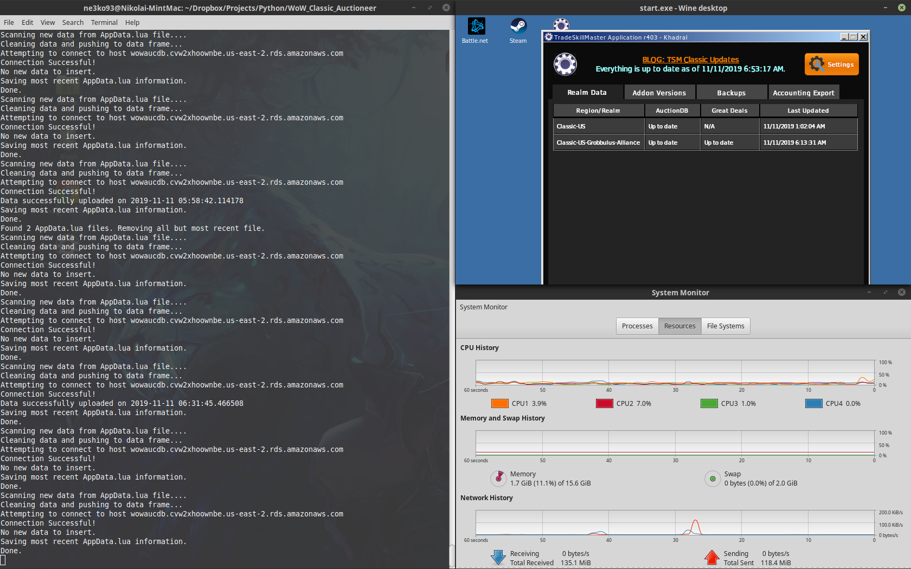
Data Collection
Script perpetually running on Linux server
Scans TradeSkillMaster data file every second – AppData.lua
If update to file, parses and preprocesses data (JSON format)
Pushes processed data to AWS server

Slide 5

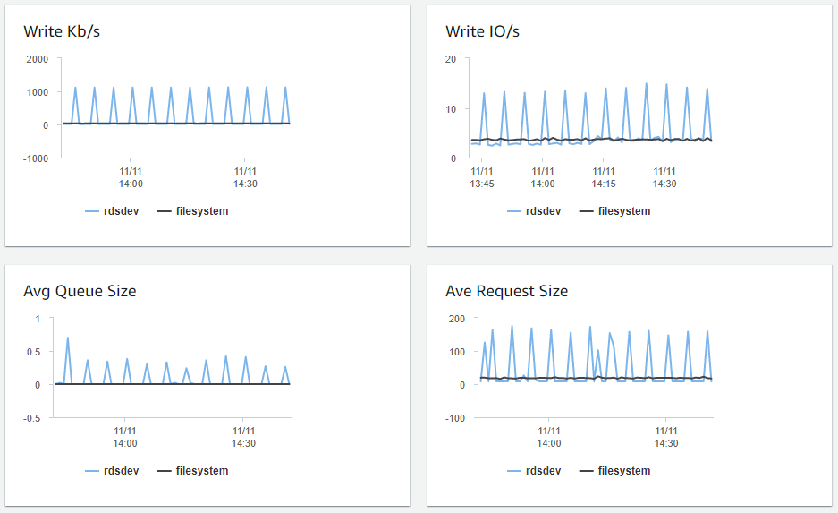
AWS Database
~695 scans over 34 days
5878 Items
Attributes: itemid, marketvalue, minbuyout, historical, numauctions, scantime
Mostly concerned with itemid, minbuyout, and numauctions so far

Slide 6

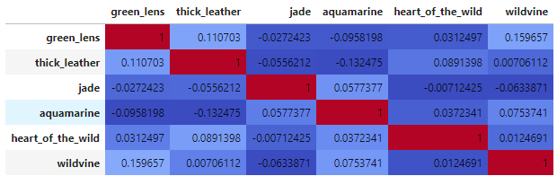
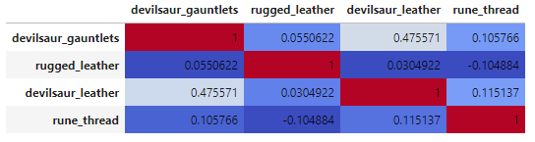
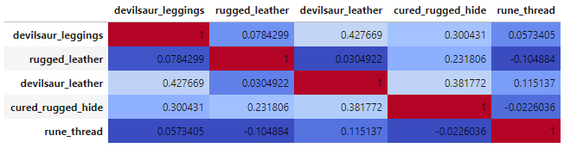
BiS Correlation
Correlations for Green Lens, Devilsaur Gauntlets, and Devilsaur Leggings
Problem – BiS are difficult to make → low qty, little data
Conclusion – Very low correlation between materials and items
Highest correlation is Devilsaur Leather & the items it creates, however, still low (~.45)

Slide 7
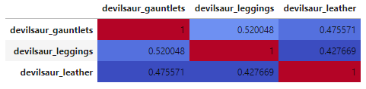
BiS Correlation – Interesting Discovery
Both Devilsaur Gauntlets & Devilsaur Leggings correlations to Devilsaur Leather are similar
Strong correlation between Devilsaur Gauntlets and Devilsaur Leggings
Why is this correlation strong? Is there a trend in the pricing?

Slide 8
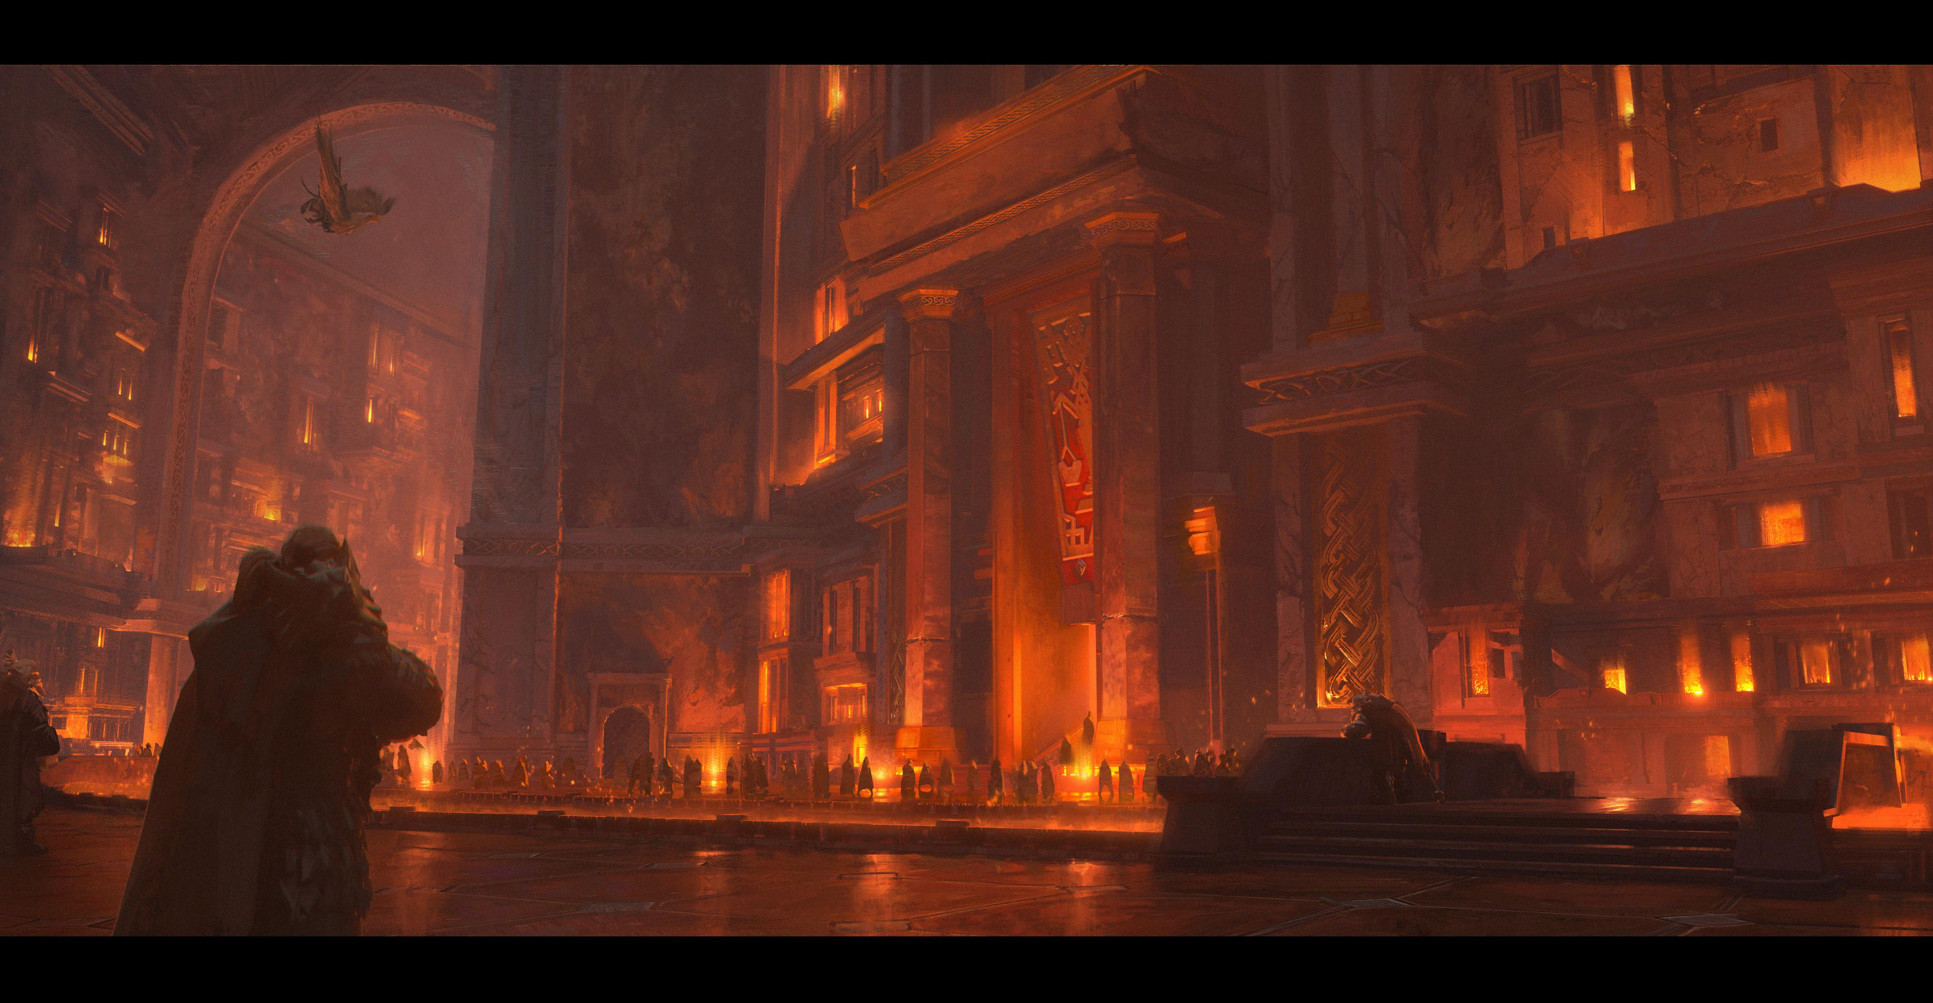
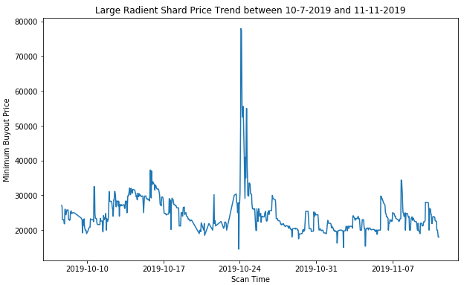
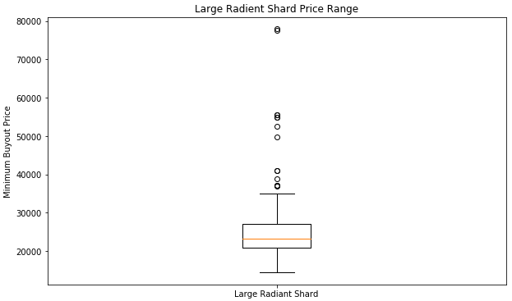
Weekly Trend – Large Radiant Shard
Item used for high level enchanting
High Trading Price and High Volatility
Prices have fluctuated rapidly over the past month
Outliers – Decided to remove, as only seen during 1 event between 10/25-10/26

Slide 9
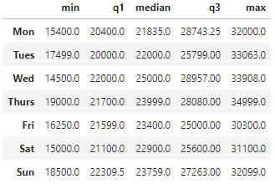
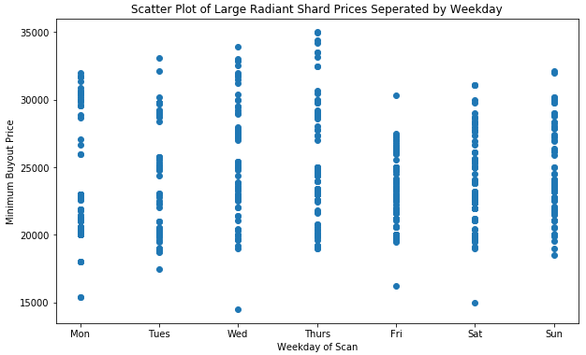
Weekly Trend – Large Radiant Shard
See a slight variation in prices throughout the week
Wed & Thurs visually look to be the highest
Friday & Weekend looks to be lower on avg
No apparent trend from Five Number Summary of each weekday
Which regression model is best? Linear? Quadratic? Cubic?
Is there a justifiable slope?

Slide 10

Future Analysis
Deeper Dive into Devilsaur Leather Craftables
Are prices of items event/patch related?
Is there a definable trend?
Correlations between other craftables and materials (Consumables & Containers)
Further Regression Analysis on Large Radiant Shard
Is there a justifiable slope? Linear? Quadratic? Cubic?
Search for & Analysis on highest volatility items
Are the price fluctuations on these items predictable?
Causes of price outliers? Are they patch/event related or purely random?

